Slide 1






BOOKLY
Full-Stack Web Application for Bookstore Management
Team Members:
Ayoub Ben Yamoune
Amirreza Jolani Mameghani
Parisa Saeedidana
Adam Truty
1

Slide 2


PATH
Introduction of Bookly
Project Goals
Changes
Tools
Main Features
Demo
2

Slide 3

WHAT IS BOOKLY?
Bookly is a full-featured web application built in Java that manages the complete lifecycle of an online bookstore:
Built using Jakarta Servlets + JSP (MVC architecture)
Powered by RESTful APIs
Integrated with PostgreSQL + Docker
Supports secure user authentication (JWT)
👉 Realistic features: shopping cart, discounts, reviews, wishlist, order history, and admin dashboard
3

Slide 4



PROJECT GOALS
Offer multiple ways to discover books : by categories, by publishers, and top rated list
Deliver a complete user journey from search to purchasement
Build the entire buying experience : wishlist, shopping cart, check out and order history.
Provide admin tools for effective bookstore management
Design a responsive, intuitive and visually engaging user interface for all devices
4

Slide 5

CHANGES SINCE HW1
POM and README file : names of the group members were missing and some dependencies were referenced several times in the POM file.
Multiple errors in javadoc generation
Updated mandatory relationships in the ER Schema
Edited and added DAOs. Set connection.setAutocommit(false) in cases where multiple statements needed to be executed as a single transacation within a DAO.
JSP pages were inappropriately injecting Java code instead of using tags
No use of Filters
Added order_items table and DAO to save cart items into orders
5

Slide 6




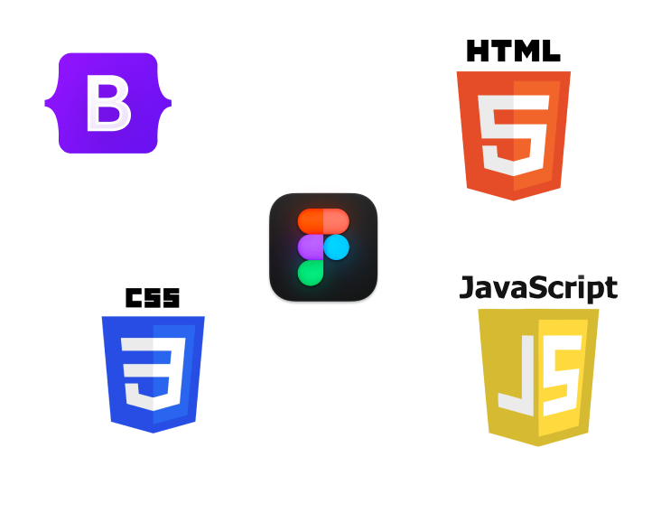


BACKEND
FRONTEND
6

Slide 7



KEY FEATURES OVERVIEW
Social Interactions
Review and rate books to provide feedback.
Bookmark favorite books.
Search for books.
User Authentication
Register and login functionality.
User and admin profile management.
Admin Management
Add new books, authors, publishers, and discounts.
View all the data on the tables.
Order Process
Process to choose and buy a book with pay in delivery or with credit cart.
Dashboard
user have their own dashboard to manage the wishlist and all the data of their profile.
7

Slide 8

LET’S PRESENT OUR APPLICATION
8

